Slide 1
DECORATOR
Group 3
Tạ Huy Hoàng
Đỗ Minh Khánh
Nguyễn Khương
Nguyễn Ngọc Long Quân

Slide 2
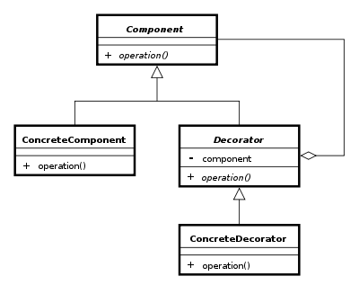
Introduction:
Expand functionality of some objects.
Inheritance (Nope)
Decorator Pattern (Yes)
Steps:
Subclass original Component class into a Decorator class (IS-A relationship)
In the Decorator class, add a Component pointer as a field. (HAS-A relationship)
In the Decorator class, pass a Component to the Decorator constructor to initialize the Component pointer
In Decorator class, foward all Component methods to the Component pointer.
Subclass the Decorator class into a ConcreteDecorator class (IS-A relationship).

Slide 3
Use Decorator
Decorator pattern allows an user to add new functionality to an existing object without altering its structure.
By designing a new Decorator class that wraps the original class.

Slide 4
Dynamic extending Vs Static extending
To Extend some functionalities of object by inheriting we have to implement codes to extend existing class and override those functions. And these works were done in compile time. In other words, we are creating a new class and the changes that we do will affects every objects of this class.
On the other hand, dynamic extending provides a mechanism that allows us modify an existed object without any effect on other objects of the same class. And all works were executed in runtime.

Slide 5
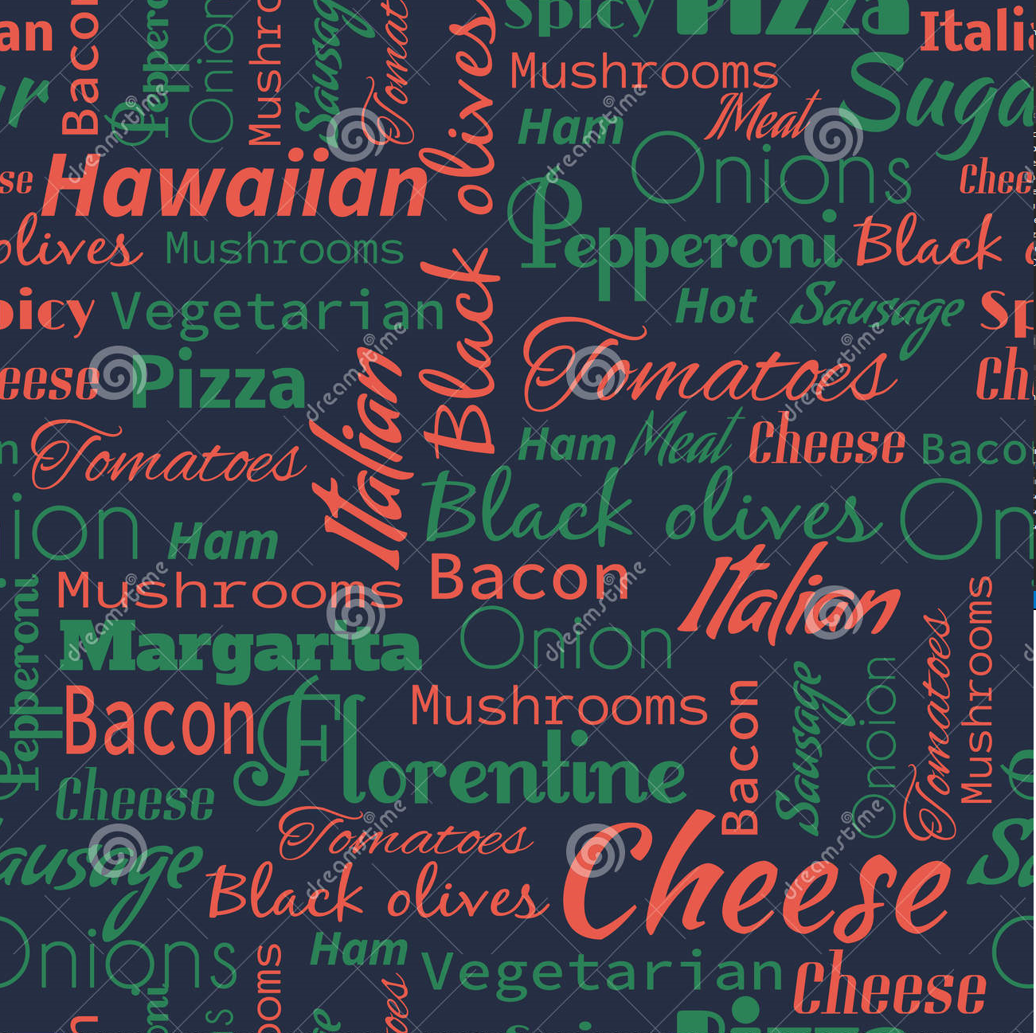
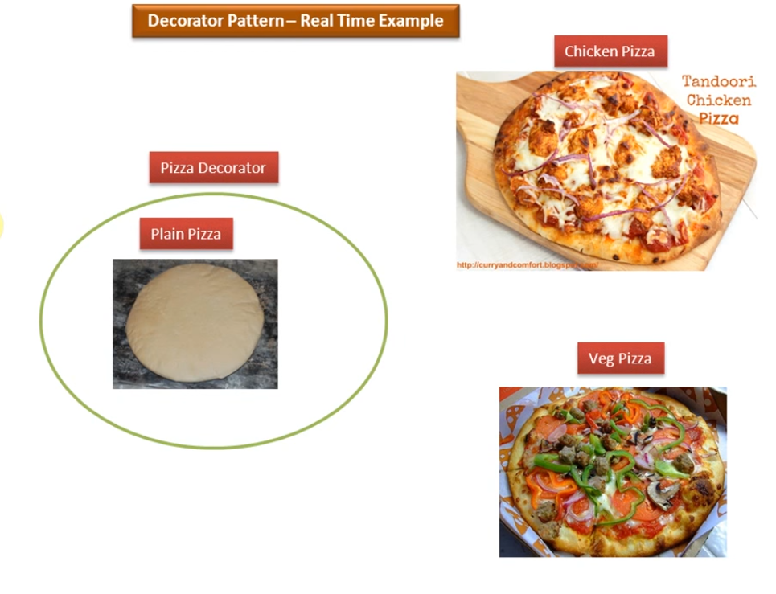

Slide 6
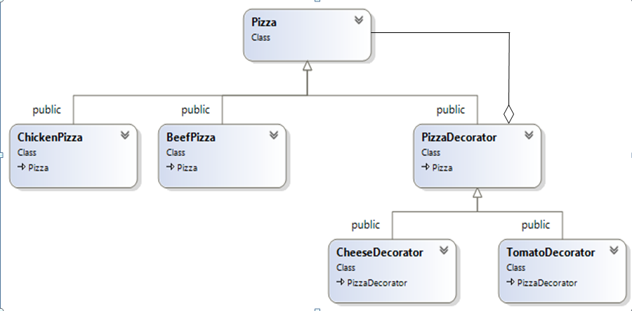
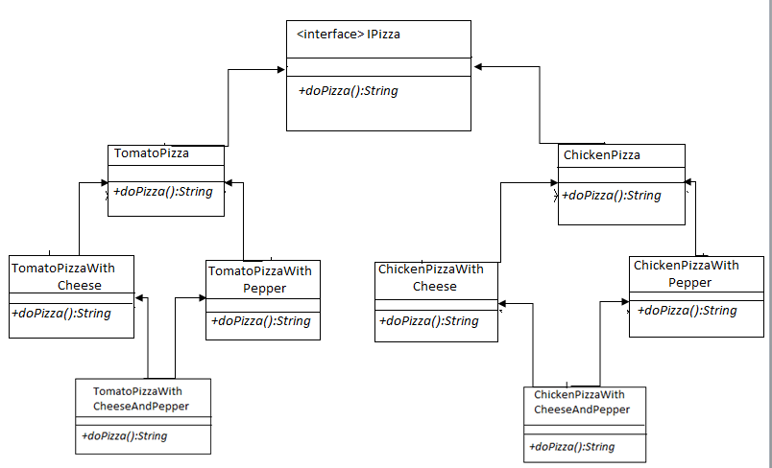

Slide 7
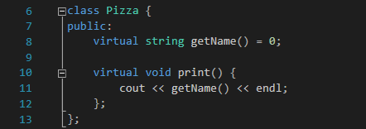
- Create an abstract class Pizza.

Slide 8
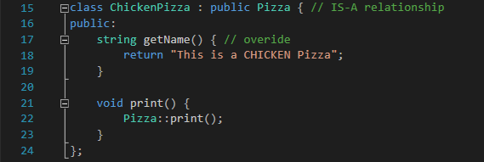
Create 2 Derived Classes: ChickenPizza and BeefPizza.

Slide 9
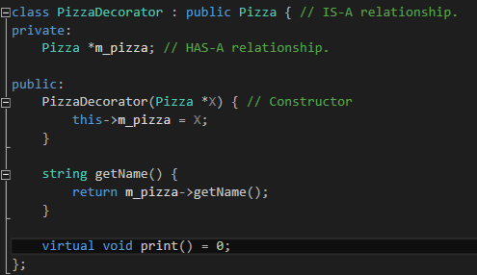
- The most important class: PizzaDecorator (abstract class)
- It gets both IS-A and HAS-A relationship with the original class Pizza.

Slide 10
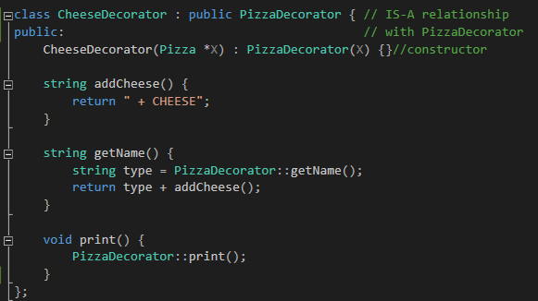
Then, the new adding ingredient class, subclass CheeseDecorator

Slide 11
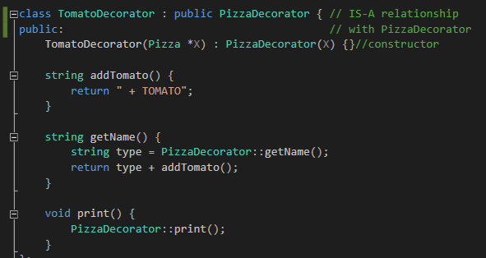
Subclass TomatoDecorator :

Slide 13
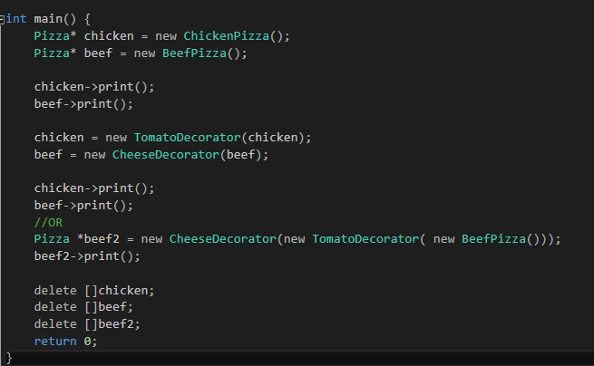

- Don’t have to create so many class.
Adding additional functionality for the origin method become flexible
Easy to arrange the source code.

Slide 14
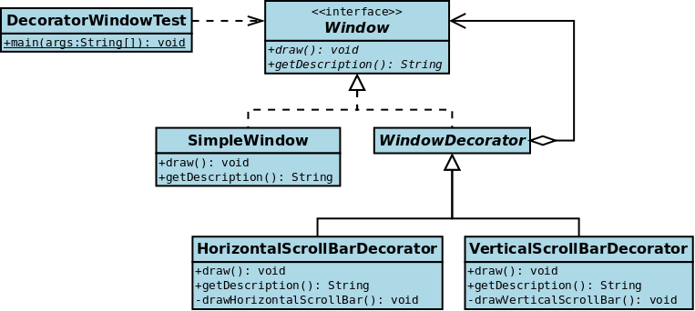
2. Window in a window system: We simply create a new BorderedWindowDecorator—at runtime, we can decorate existing windows with the ScrollingWindowDecorator or the BorderedWindowDecorator or both

Slide 15
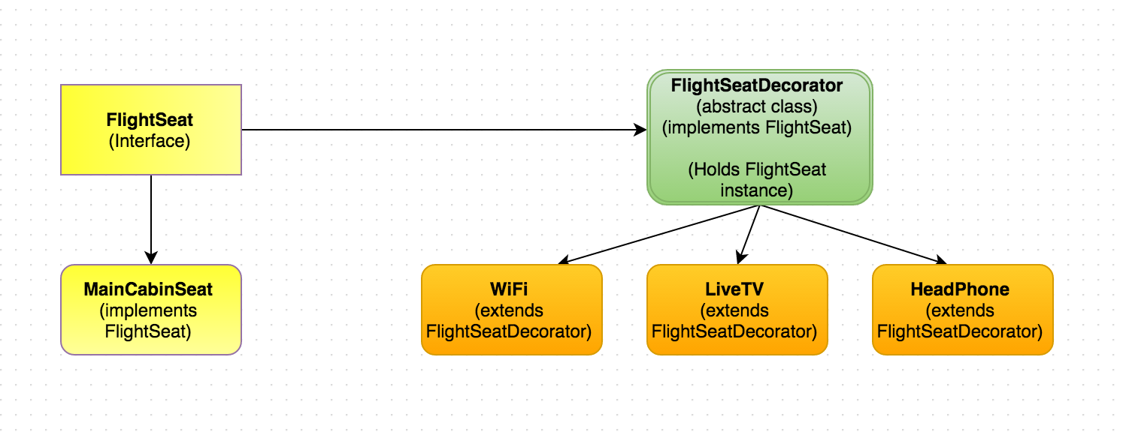
3. Flight Seat:

Slide 16
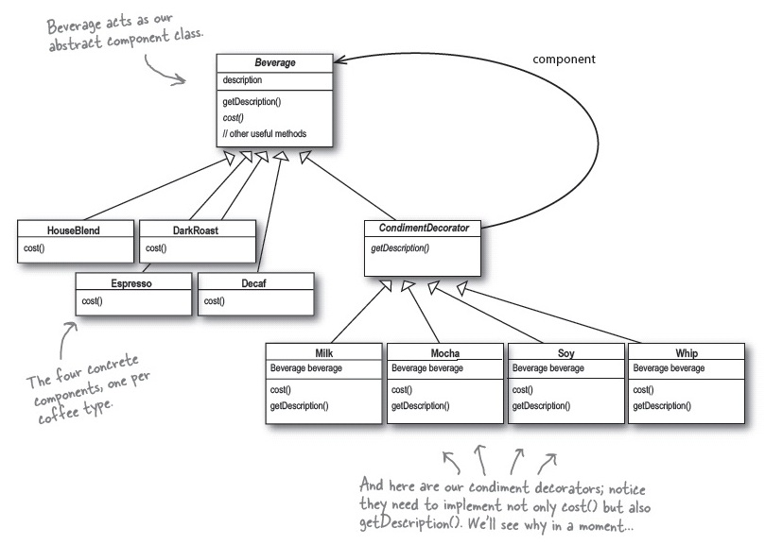
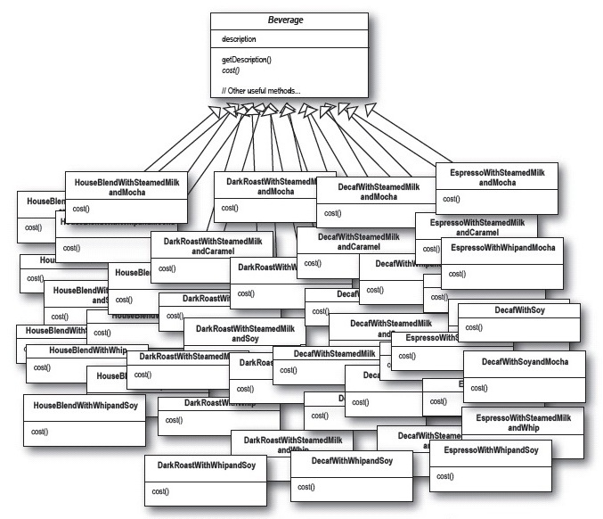
4. Coffee shop Menu

Slide 17
Pros
* Decorators provide a flexible alternative to subclassing for extending functionality
* Decorators allow behavior modification at runtime rather than going back into existing code and making changes
* Decorators are a nice solution to permutation issues because you can wrap a component with any number of decorators
*The decorator pattern supports the principle that classes should be open for extension but closed for modification

Slide 18
Cons
* Decorators can result in many small objects in our design, and overuse can be complex
* Decorators can cause issues if the client relies heavily on the components concrete type
* Decorators can complicate the process of instantiating the component because you not only have to instantiate the component but wrap it in a number of decorators
* It can be complicated to have decorators keep track of other decorators because to look back into multiple layers of the decorator chain starts to push the decorator pattern beyond its true intent

Slide 19
Reference
https://en.wikipedia.org/wiki/Decorator_pattern
http://stackoverflow.com/questions/1549743/when-to-use-the-decorator-pattern
https://viblo.asia/dang.quyet.tien/posts/pVYRPjbVG4ng
http://dbox.nguyentrungduy.com/decorator-pattern/
https://sourcemaking.com/design_patterns/decorator

